Slide 1
TypeScript
TypeScript is a typed superset of JavaScript that compiler to plain JavaScript.
Any browser. Any host. Any OS .Open source

Slide 2
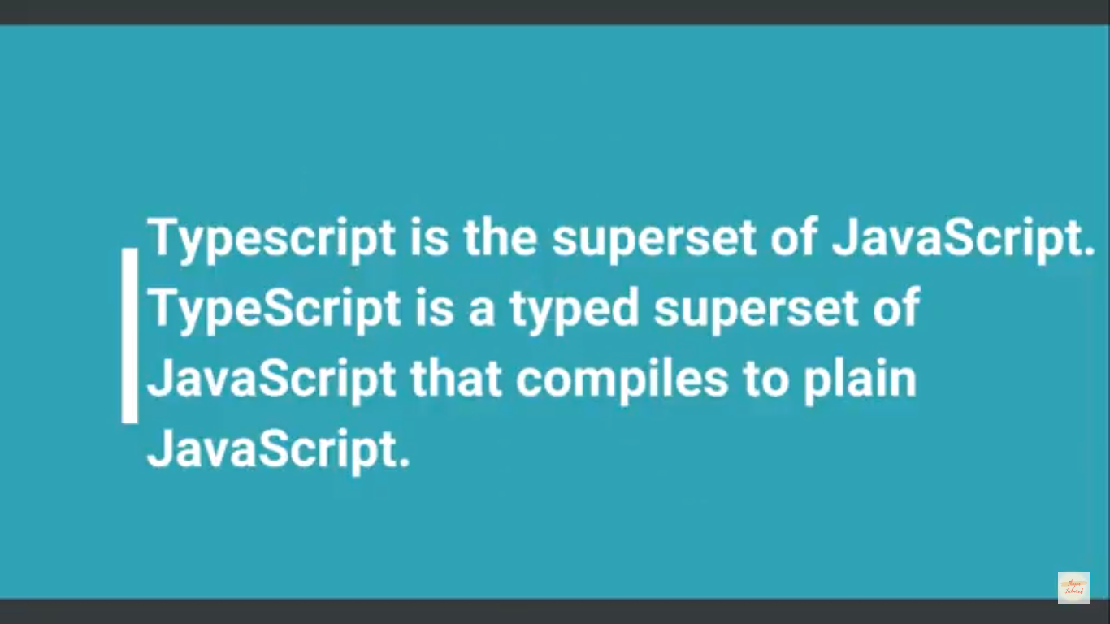

Slide 3
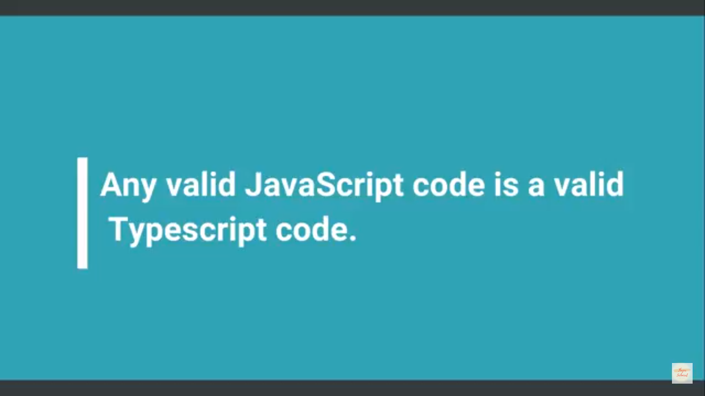

Slide 4
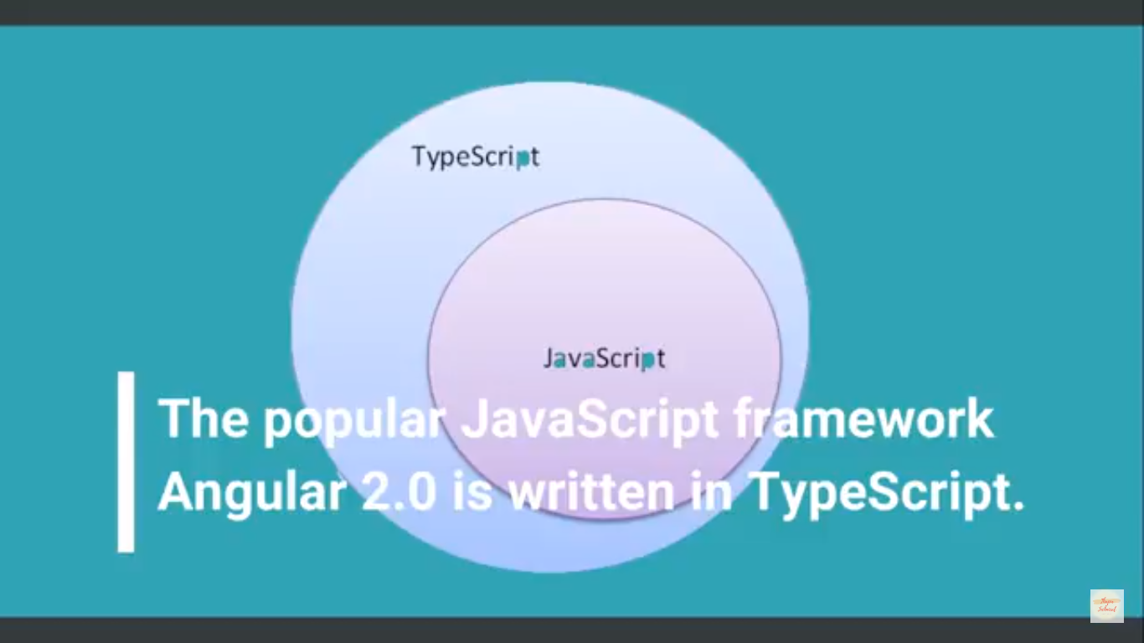

Slide 5
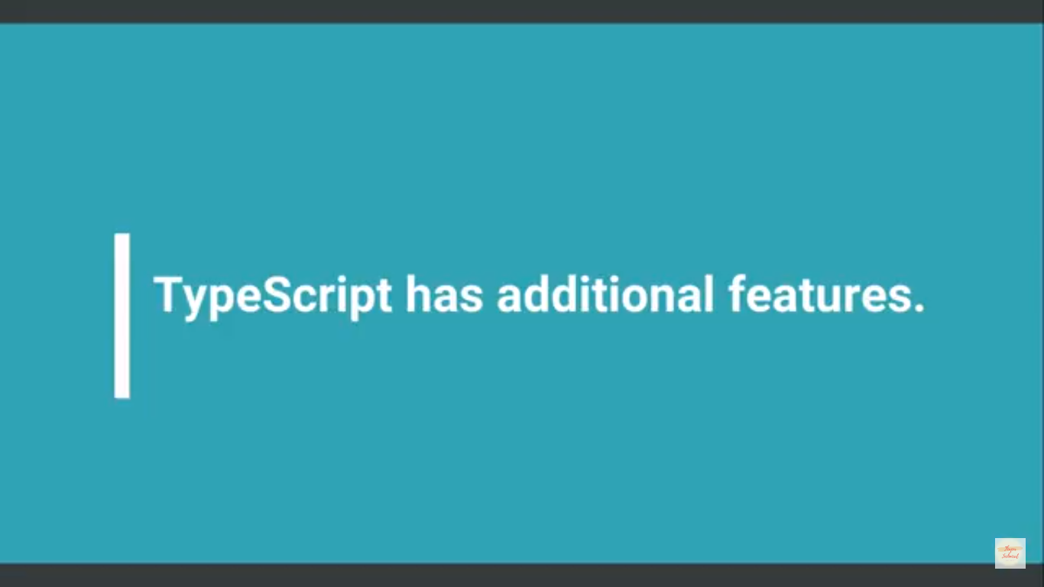

Slide 6


Slide 7
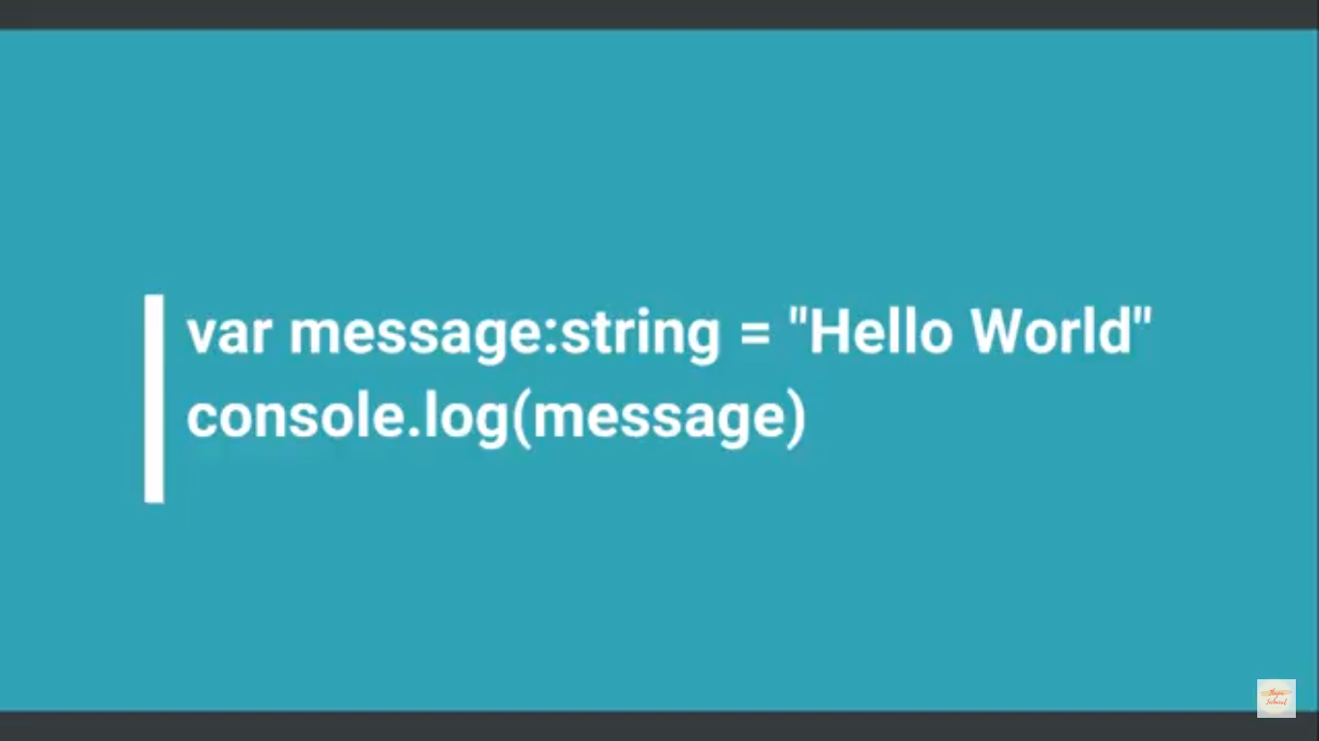

Slide 8
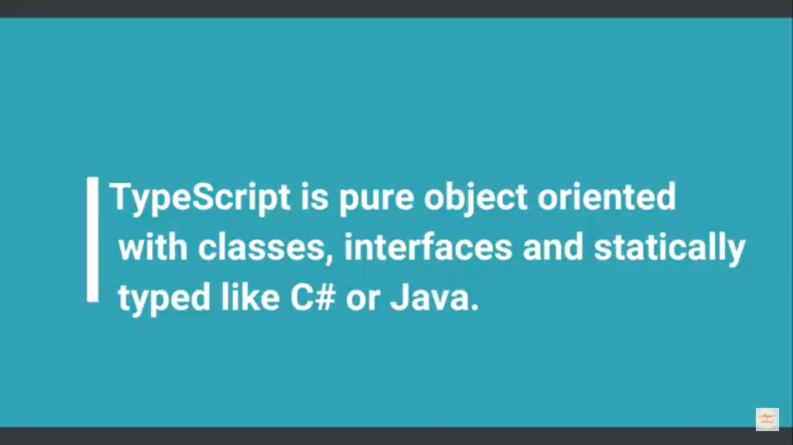

Slide 9
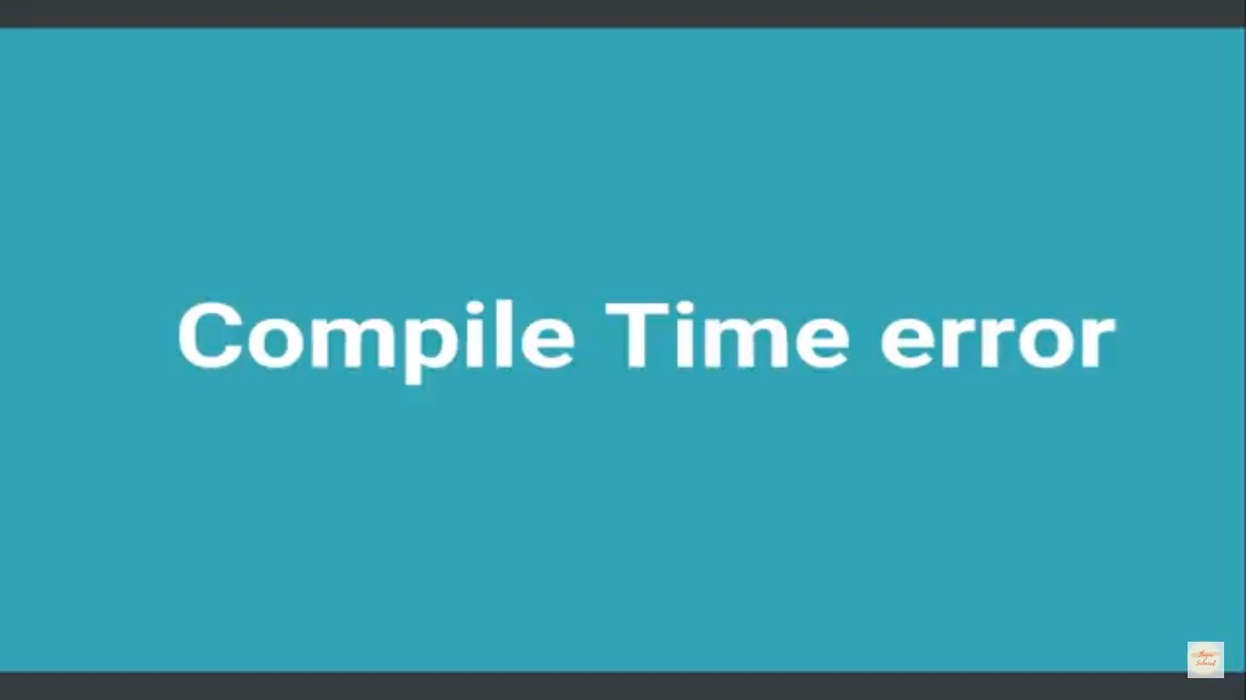

Slide 10
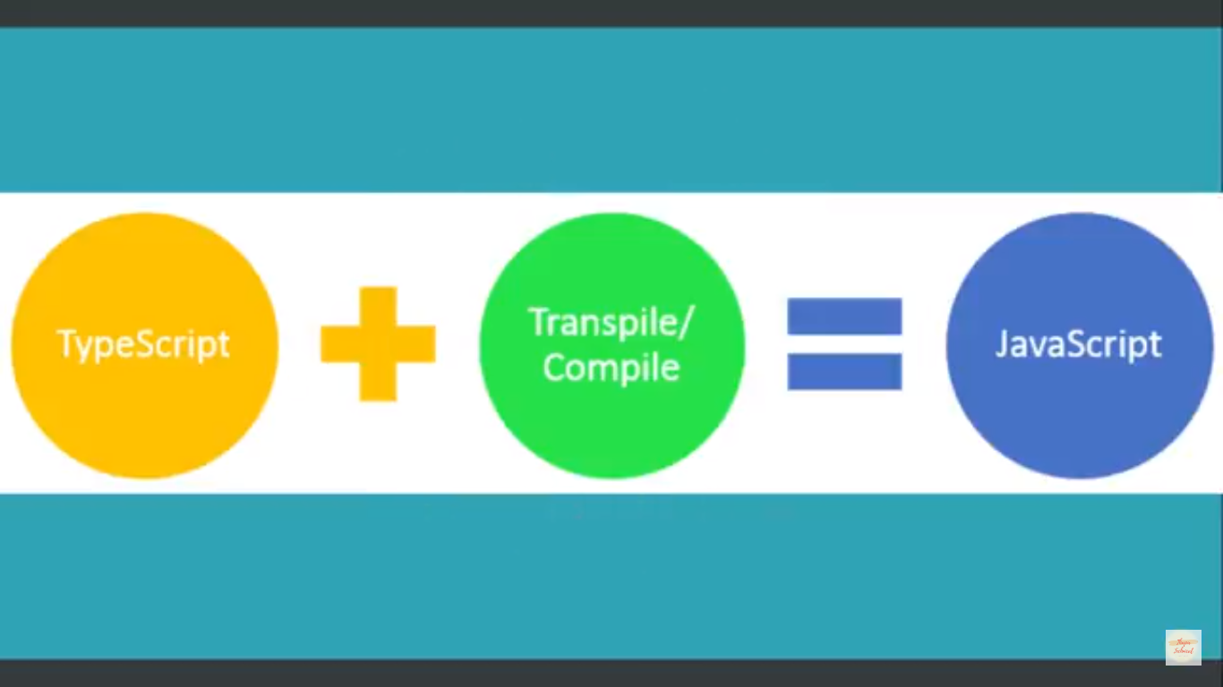

Slide 11
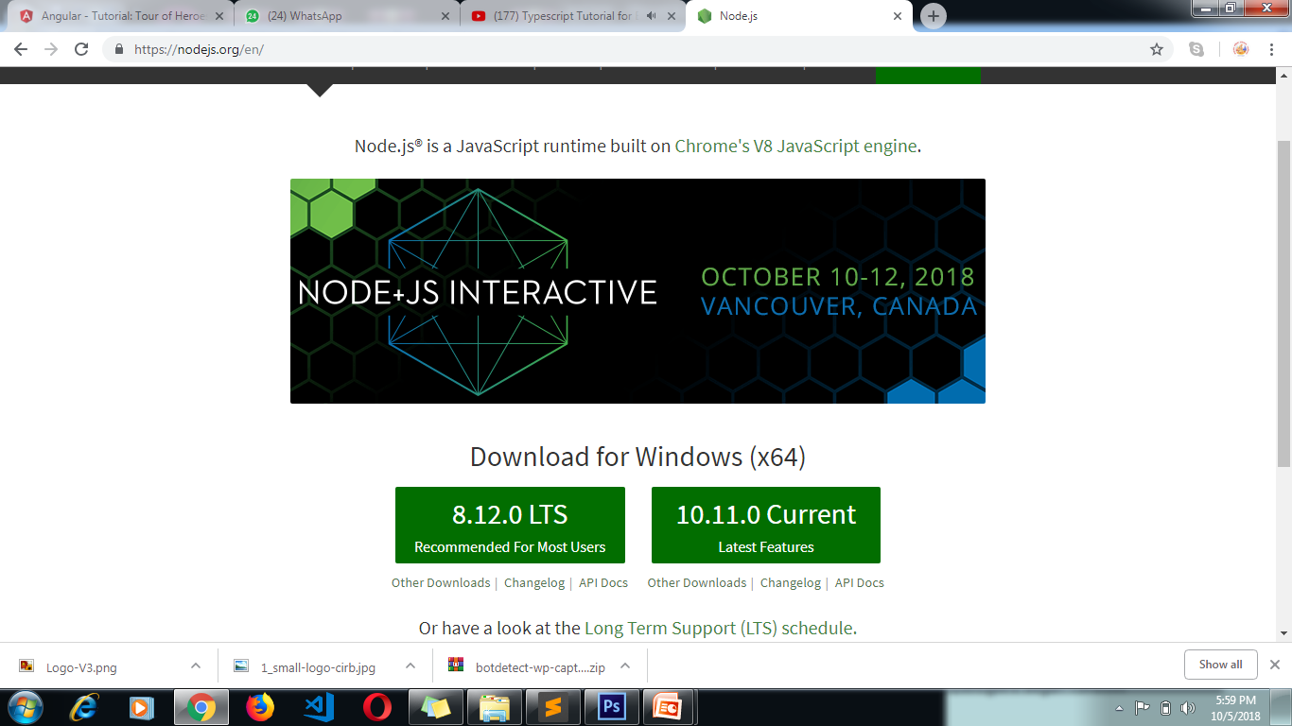
Install Typescript( Node Js Insatll)

Slide 12
Node js and typescript install
Node.js® is a JavaScript runtime built on Chrome's V8 JavaScript engine
1. CMD
2.node –version
node –v
npm install -g typescript (note package manager)
tsc—version
cd..
e:
mkdir typescript(new folder)
cd typescript\
Visualstudio
https://code.visualstudio.com/docs?dv=win&wt.mc_id=DX_841432&sku=codewin

Slide 13
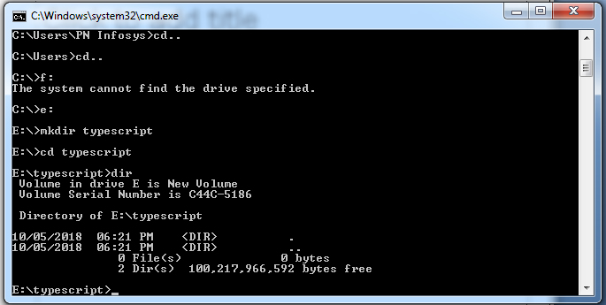

Slide 14
Variable
compile time run
1.var
2.let
3.ES5(ECMASCRIPT)Standard VAR
4.ES6 2015 VAR LET(keyboard)
ES2016
ES2017
Var is scoped to the nearest function block..
Let is scoped to the nearest enclosing block..

